Slide 1


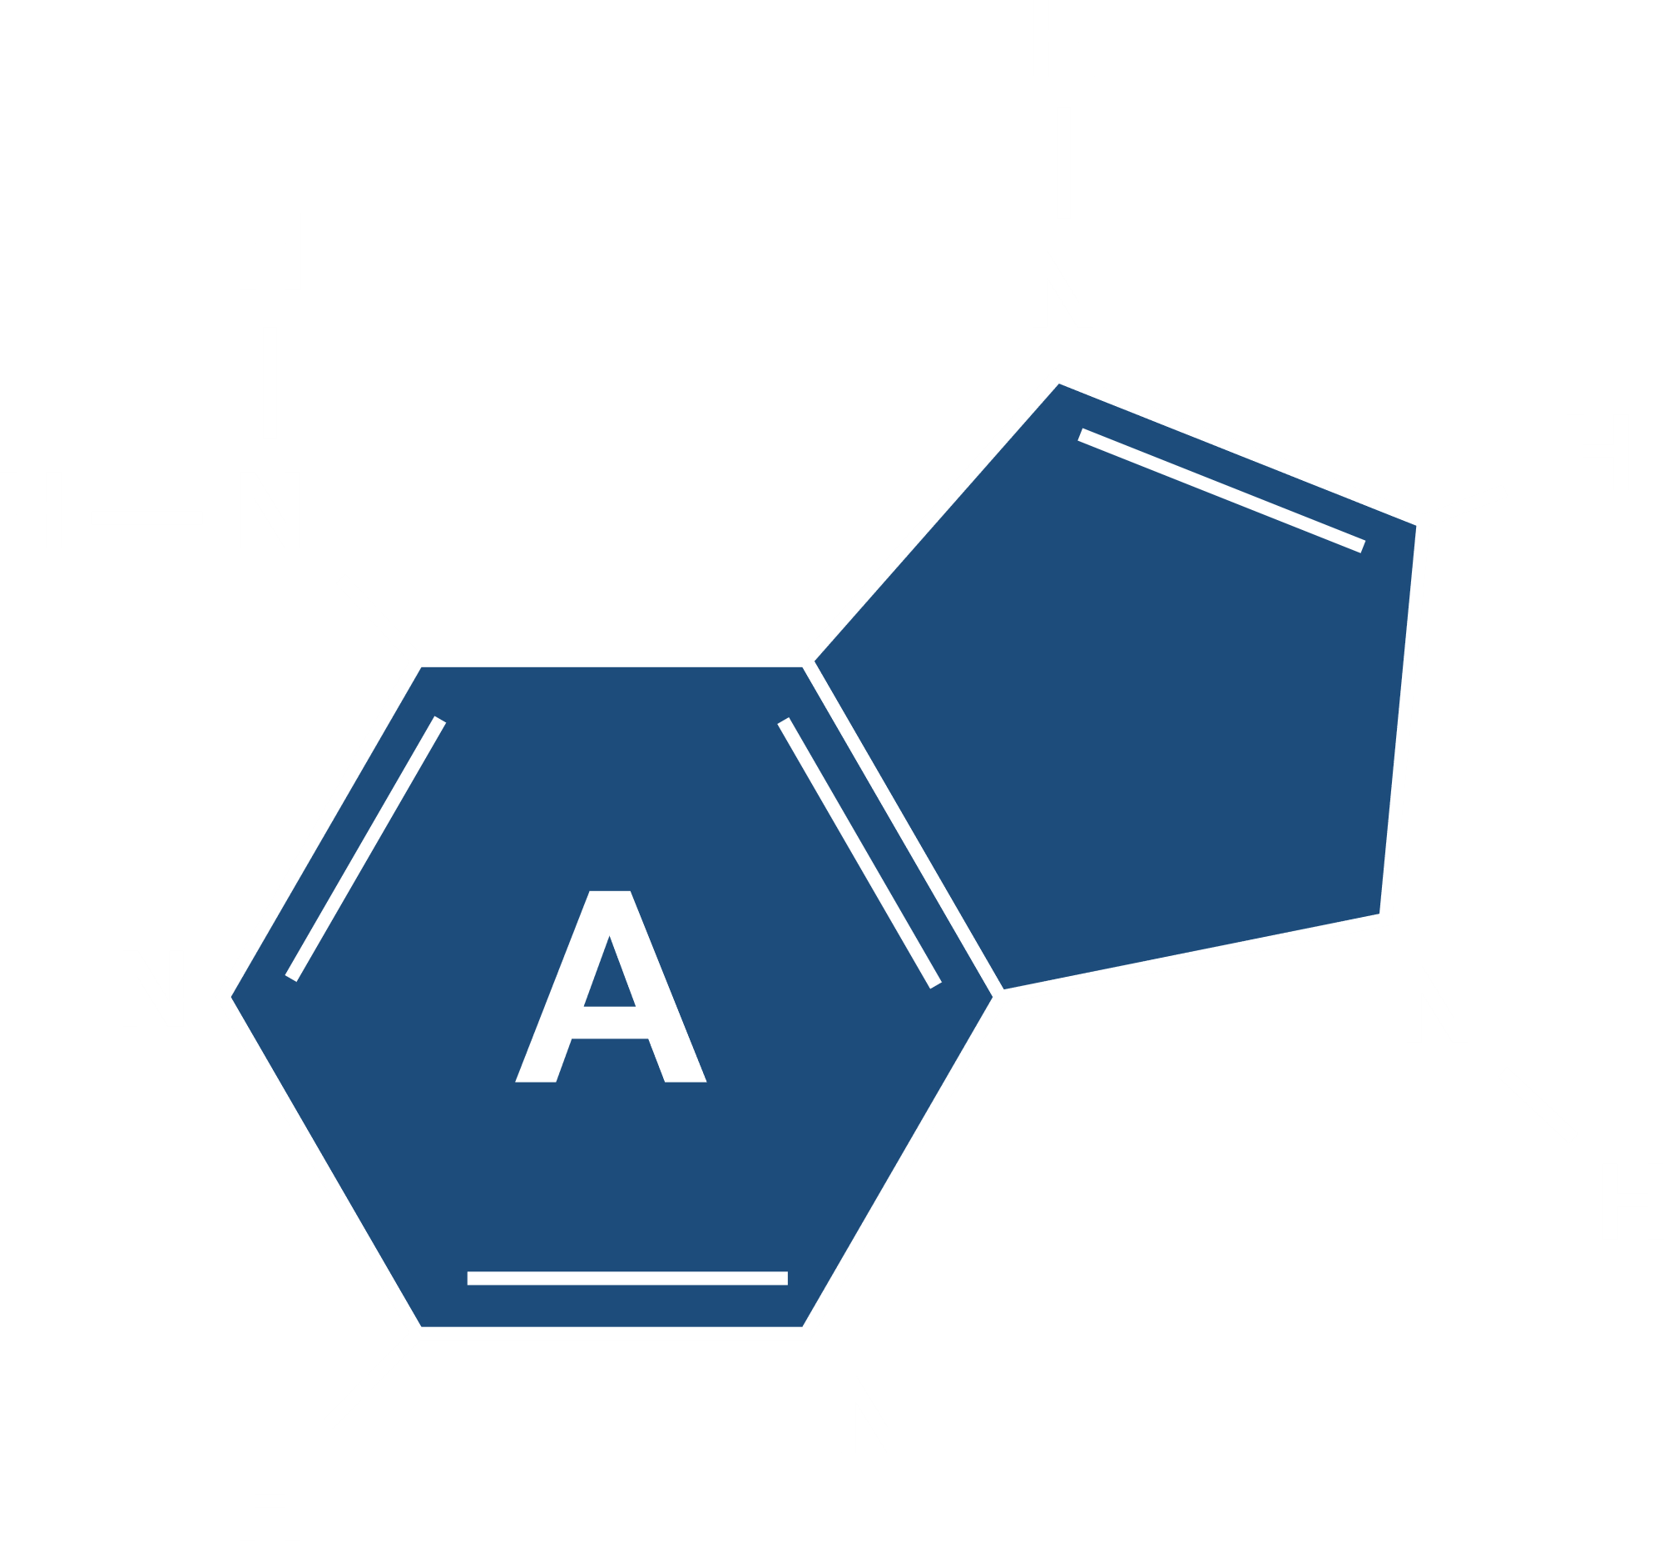
CLASSIFICATION AND ANALYSIS OF TYPE OF SPINAL MUSCULAR ATROPHY
By: Creig Luke Picardo (232626036)
Sowmya M Kamath (232626011)
Harishankar Arun C (232626033)

Slide 2

TABLE OF CONTENTS
01
02
Introduction
Literature Review
03
04
Research Methodology
Data Analysis And Interpretation

Slide 3
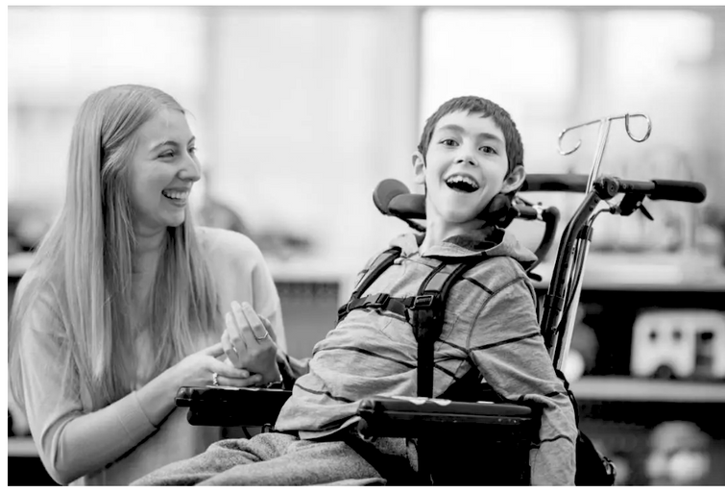
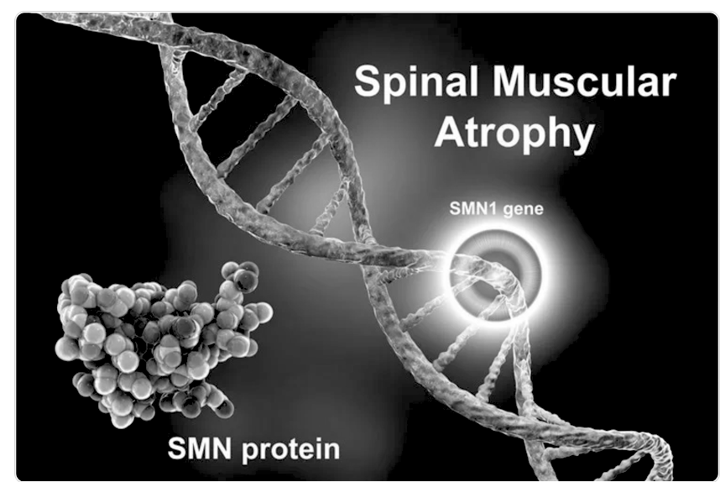
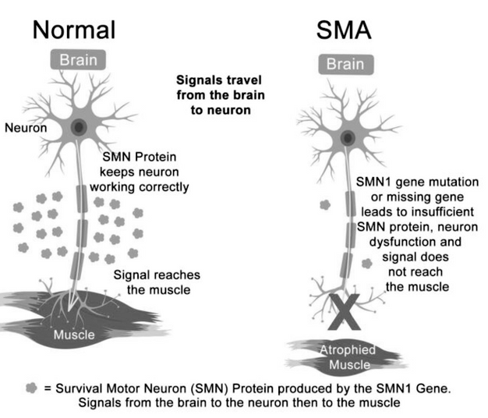
INTRODUCTION
What is SMA?
Why is it Important?
Advancements in Treatment:
Spinal Muscular Atrophy (SMA) is a rare genetic disorder that affects motor neurons in the spinal cord, leading to progressive muscle weakness and loss of mobility
SMA is a leading genetic cause of infant mortality, but its impact extends across all age groups, emphasizing the need for effective diagnosis, treatment, and management.
Breakthroughs in gene therapy, innovative drugs, and machine learning applications in early detection are transforming the landscape of SMA care, improving patient outcomes and quality of life.

Slide 4
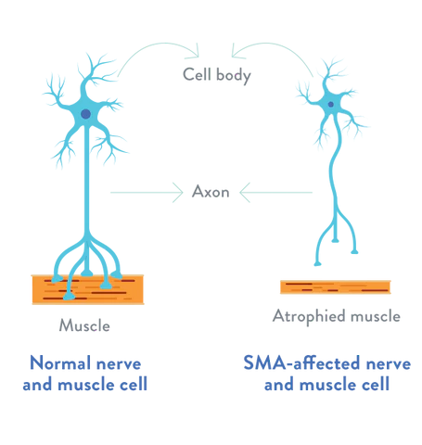
INTRODUCTION
Spinal Muscular Atrophy (SMA) is a genetic disease caused by mutations in the SMN1 and SMN2 genes.
SMA leads to voluntary muscle atrophy due to motor neuron degeneration.
One of the leading genetic causes of infant mortality.

Slide 5

INTRODUCTION
Machine Learning (ML) offers promising advancements by analyzing complex clinical data to predict disease likelihood, progression, severity, and treatment outcomes.
This research aims to classify SMA types using ML models based on age, genetic, and locomotory factors.

Slide 6


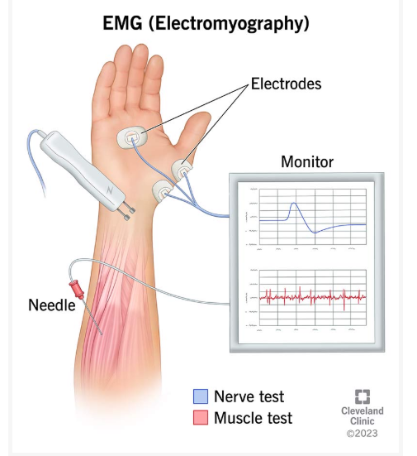
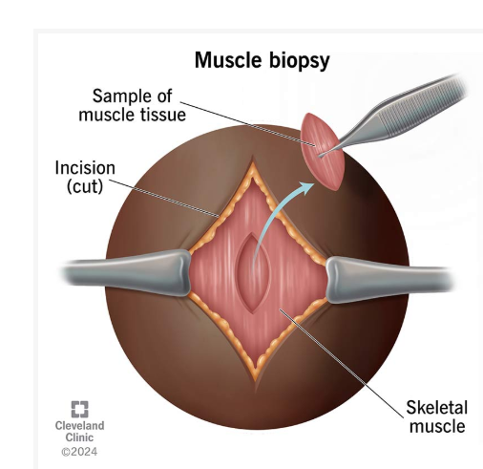
DIAGNOSIS OF SMA
Genetic Testing
Electromyography
Muscle Biopsy

Slide 7




TYPES OF SMA
SMA Type 1
SMA Type 2
SMA Type 3
SMA Type 4

Slide 8
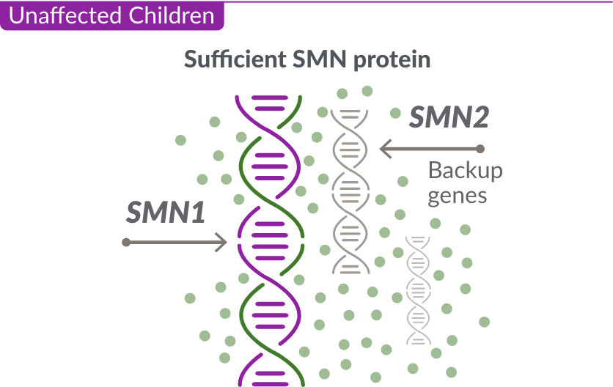
SURVIVOR MOTOR NEURON
SMN 1
SMN 2

Slide 9

LITERATURE REVIEW
Sources | Objectives | Methodology | Findings
Nishio et al. (2024) | To examine the historical evolution and advancements in SMA diagnosis and treatment. | Comprehensive review of past techniques, recent innovations, and future trends. | Advancements in genetic and molecular diagnostics have significantly reshaped SMA management.
Pankaj et al. (2024) | To identify latest treatment strategies and persisting challenges in SMA care. | Review of therapeutic advancements in SMA. | Highlighted breakthroughs in treatment but emphasized ongoing challenges in effective care delivery.
Haque & Yokota (2024) | To explore gene-targeting therapies for SMA and their clinical potential. | Analysis of gene-replacement (SMN1) and gene-modulation (SMN2) therapies. | Demonstrated the promise of gene-targeting interventions but noted challenges in clinical applications.
Lipnick et al. (2024) | To investigate SMA’s broader impact on patients and healthcare systems. | Utilization of insurance claims data for systemic analysis. | Revealed the systemic burden of SMA, extending beyond motor neuron degeneration.

Slide 10
LITERATURE REVIEW
Sources | Objectives | Methodology | Findings
Tapken et al. (2024) | To explore SMA’s molecular complexity and its impact on biological pathways. | Examination of molecular pathways affected by SMA. | Demonstrated SMA as a multifaceted disorder affecting pathways beyond motor neurons.
Sun et al. (2024) | To identify cellular and molecular mechanisms underlying SMA using severe mouse models. | Single-cell RNA sequencing on spinal cord cells in mouse models. | Identified dysregulated spinal cord cell types, paving the way for targeted interventions to restore cellular homeostasis.
Maretina et al. (2024) | To highlight the role of biomarkers in monitoring SMA progression and treatment efficacy. | Analysis of biomarkers in the treatment era. | Biomarkers were found to refine patient management by tracking disease progression and therapeutic responses.
De Lemus et al. (2024) | To understand the psychosocial dimensions of SMA affecting patients and caregivers. | Qualitative study under the PROfuture project. | Revealed significant physical and emotional burdens associated with SMA, emphasizing the need for comprehensive support systems.

Slide 11
OBJECTIVE OF THE STUDY
1
2
3
Classify the type of SMA
Key Factor Identification
Impact Analysis of Factors
To classify the type of Spinal Muscular Atrophy of an individual based on the genetic and locomotory factors of the disease.
To check which factors are the most important and pivotal and deciding the Type of SMA of an individual.
To analyze how each of the genetic and locomotory factors help in influencing the type of SMA an individual has.

Slide 12
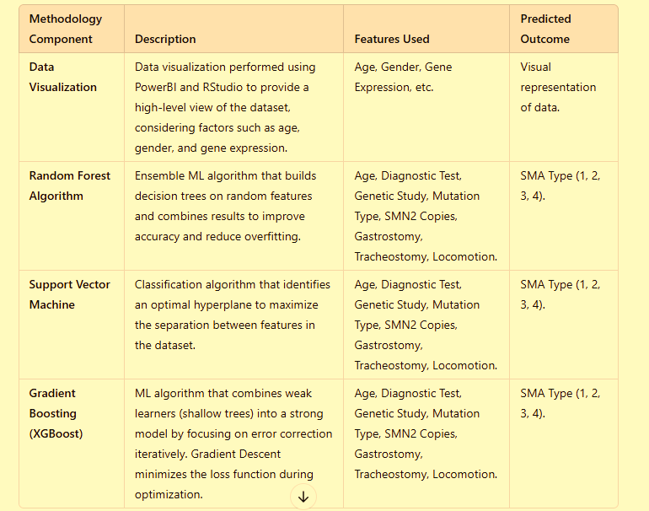

RESEARCH METHODOLOGY

Slide 13
RESEARCH METHODOLOGY
Variables used for analysis
Diagnosis Age The age at which SMA was diagnosed.
Diagnostic Test Type : Diagnostic method used for SMA detection; Multiplex ligation-dependent probe amplification (MLPA) or Sequencing
Zygosity - Genetic Study Result: Zygosity (whether an individual has one or both defective SMN1 genes).
Mutation Type : Mutation Types being Point mutation, exon-7 deletion, Deletion of exon 7 to 8, duplication of exon 7 to 8.
SMN2 Copies : The number of copies of the genetic material SMN2. The copies can range in quantity from 1 to 5.
Gastrostomy : The factor for patients requiring a feeding tube (gastrostomy).
Tracheostomy : The factor for patients requiring a breathing tube (tracheostomy).
Locomotion : The amount of movement the patient with SMA can make: No movement, minimal movement, Sit, Walk, or mild leg weakness.

Slide 14
DESCRIPTIVES
 | vars | n | mean | sd | median | trimmed | mad | min | max
Diagnosisage | 1 | 201 | 12.53 | 12.72 | 9 | 10.14 | 8.90 | 1 | 61
RGender | 2 | 201 | 1.42 | 0.50 | 1 | 1.40 | 0.00 | 1 | 2
RDiagnosticTest | 3 | 201 | 1.06 | 0.25 | 1 | 1.00 | 0.00 | 1 | 2
RGeneticStudy | 4 | 201 | 1.08 | 0.28 | 1 | 1.00 | 0.00 | 1 | 2
RMutationType | 5 | 201 | 2.30 | 0.65 | 2 | 2.37 | 0.00 | 1 | 4
RSMN2Copies | 6 | 201 | 2.87 | 0.74 | 3 | 2.84 | 0.00 | 1 | 5
RGastrostomy | 7 | 201 | 0.09 | 0.29 | 0 | 0.00 | 0.00 | 0 | 1
RTracheostomy | 8 | 201 | 0.07 | 0.26 | 0 | 0.00 | 0.00 | 0 | 1
RLocomotion | 9 | 201 | 3.21 | 1.05 | 3 | 3.21 | 1.48 | 1 | 5
SMAtype* | 10 | 201 | 2.22 | 0.92 | 2 | 2.17 | 1.48 | 1 | 4
Notes:
The mean age of the individuals is 12.5 years. Majority of individuals having SMA exhibit some form of locomotory movement. Majority of the individuals have more than 2 SMN2 gene Copies. Majority of the individuals do not need a gastrostomy or tracheostomy tube. This table summarizes key statistics for 10 variables over 201 observations:
Diagnosissage has the widest range (1–61) with a mean of 12.53 and high variability (SD = 12.72).
RLocomotion shows a range of 1–5, with the highest mean (3.21) and moderate spread (SD = 1.05).
Variables like RGastrostomy and RTracheostomy have minimal variability (SD < 0.3) and limited ranges (0–1).

Slide 15
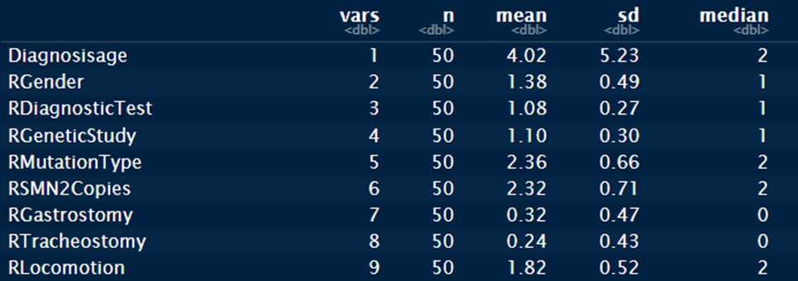
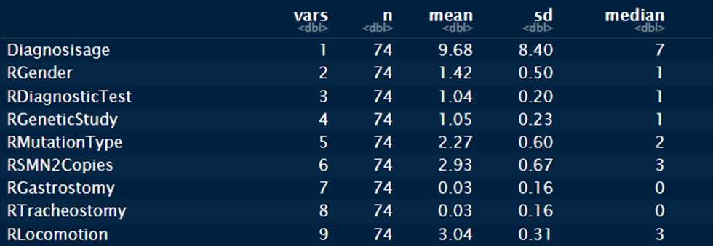
DESCRIPTIVES
SMA TYPE 1
SMA TYPE 2
Notes:
For SMA Type 1, the mean age is 4 years, and most individuals have very minimal movement (1.82). The mean amount of SMN2 Copies is 2.32. A good 1/3rd of the individuals (0.32) need a gastrostomy tube and 1/4th of the individuals need a tracheostomy tube. For SMA Type 2, the mean age is 9.7 years, and most individuals have very decent leg and body movement (3.04). The mean amount of SMN2 Copies is 2.93. Only a small number of individuals need a gastrostomy and tracheostomy tube.

Slide 16
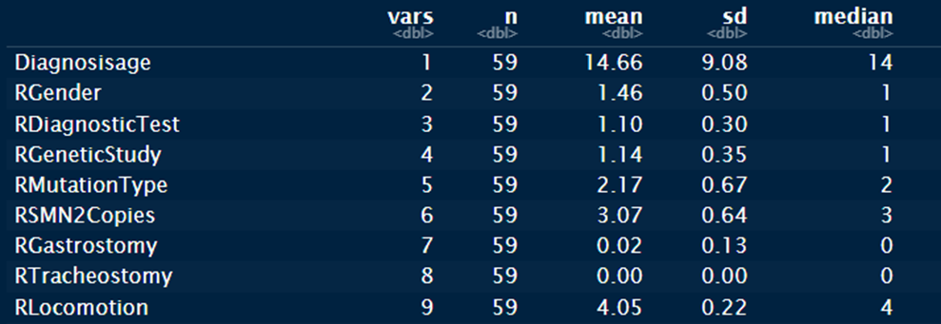
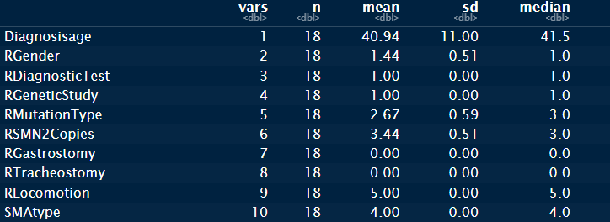
DESCRIPTIVES
SMA TYPE 3
SMA TYPE 4
Notes:
For SMA Type 3, the mean age is 14.66 years, and most individuals have very decent leg and body movement (4.05). The mean amount of SMN2 Copies is 3.07. Negligible individuals need a gastrostomy tube, and no individual requires a tracheostomy tube for SMA Type 3. For SMA Type 4, 40.9 years is the mean age, and all individuals have good leg and body movement, with only mild muscle weakness (5). The mean amount of SMN2 Copies is 3.44. No individual of SMA Type 4 needs a gastrostomy or tracheostomy tube.

Slide 17
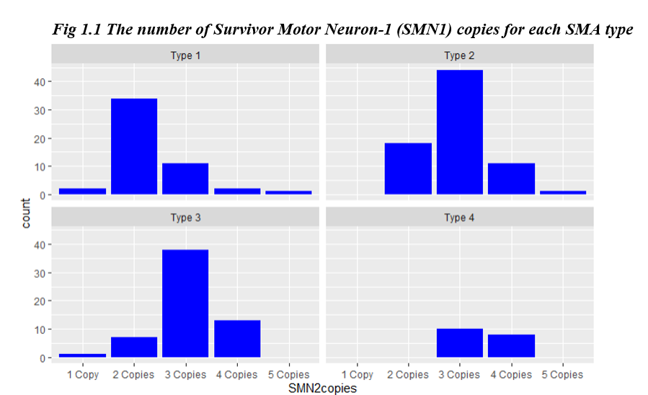
DATA VISUALIZATION
Notes:
Gender: SMA affects both genders equally, with minimal impact on SMA type, though it may affect clinical outcomes and healthcare access.
Diagnosis Age: Earlier diagnosis (infancy) is linked to severe forms (Type 1), while later diagnosis (adulthood) tends to indicate milder forms (Types 3 and 4).
Diagnostic Test Type: Genetic testing is key for confirming SMA and its type, but the test type doesn’t influence disease severity.
Zygosity: Homozygous mutations (two defective SMN1 genes) are linked to severe forms of SMA, while heterozygous mutations can lead to milder types.(heterozygos and hemozygoes)
Mutation Type: Specific mutations in the SMN1 gene affect severity, with certain mutations being associated with severe (Type 1) or milder (Types 3 and 4) forms.
SMN2 Copies: More copies of the SMN2 gene usually lead to milder forms of SMA by producing more functional SMN protein.
Gastrostomy: Patients requiring feeding tubes often have severe SMA (Types 1 or 2) due to muscle weakness affecting swallowing.
Tracheostomy: Needed in severe cases (Types 1 and 2) for respiratory support; less common in milder types (Types 3 and 4).
Locomotion: Key in classifying SMA types—Type 1 has no movement, Type 2 can sit upright, Type 3 can walk short distances, and Type 4 has minimal weakness with almost normal movement.
This figure illustrates the distribution of SMN2 copies across different SMA types:
Type 1: Majority have 2 SMN2 copies, reflecting severe disease progression due to insufficient SMN protein production.
Type 2: Predominantly 3 SMN2 copies, correlating with intermediate severity.
Type 3: Majority with 3 copies, some with 4 copies, showing milder symptoms than Type 2.
Type 4: Primarily 3 and 4 copies, highlighting its mild and late-onset nature.

Slide 18
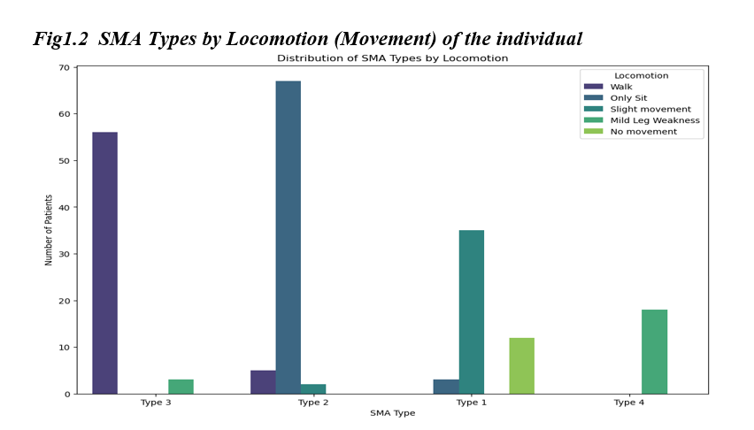
DATA VISUALIZATION
Notes:
interpretation:

Slide 19
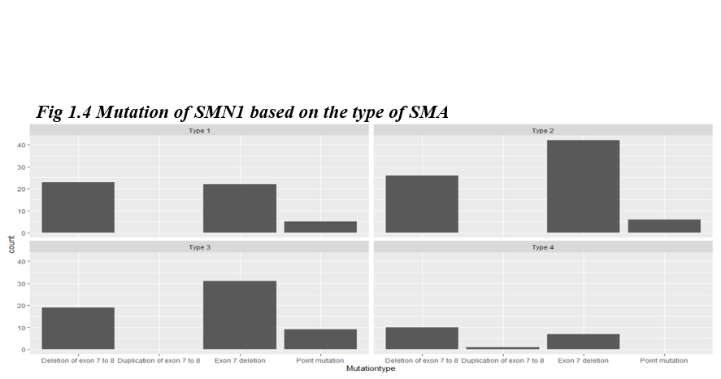
DATA VISUALIZATION
Notes:
Interpretation: bar plot illustrates the distribution of SMN1 mutations across different SMA types:
Type 1: Primarily characterized by deletion of exon 7 to 8, with some exon 7 deletions and a few point mutations.
Type 2: Dominated by deletion of exon 7 to 8, with minimal point mutations.
Type 3: Shows significant exon 7 deletions, alongside deletions of exon 7 to 8.
Type 4: Predominantly exon 7 deletions with a smaller count of exon 7 to 8 deletions.
This highlights the predominant role of exon 7 to 8 deletions across severe SMA types, particularly Type 1 and 2.

Slide 20
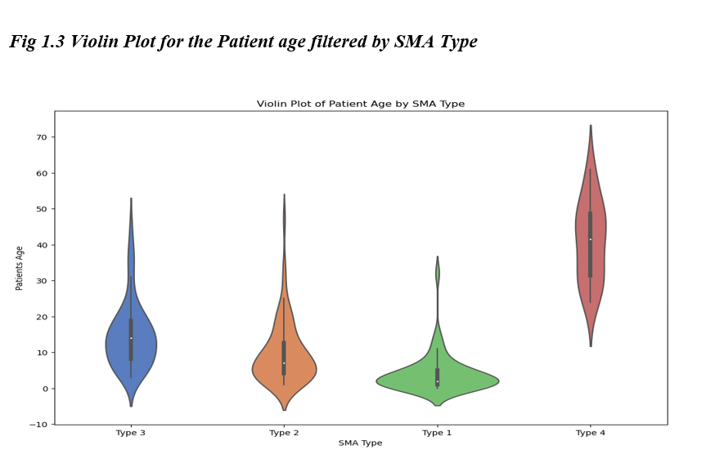
DATA VISUALIZATION
Notes:
Interpretation: he width of each shape represents the density of age distribution for that SMA type. The central black box indicates the interquartile range, with the white dot representing the median age. Notable observations:
Type 1 SMA has a narrow age range concentrated at younger ages.
Type 2 shows a broader distribution but skews younger.
Type 3 spans a larger range with a median age in the middle.
Type 4 patients tend to be older with a wider age spread.

Slide 21
DATA ANALYSIS
Machine Learning Models Used:
Random Forest Model (RF)
Support Vector Machine (SVM)
Gradient Boosting Model (XGBoost)
Notes:
For SMA Type 3, the mean age is 14.66 years, and most individuals have very decent leg and body movement (4.05). The mean amount of SMN2 Copies is 3.07. Negligible individuals need a gastrostomy tube, and no individual requires a tracheostomy tube for SMA Type 3. For SMA Type 4, 40.9 years is the mean age, and all individuals have good leg and body movement, with only mild muscle weakness (5). The mean amount of SMN2 Copies is 3.44. No individual of SMA Type 4 needs a gastrostomy or tracheostomy tube.

Slide 22
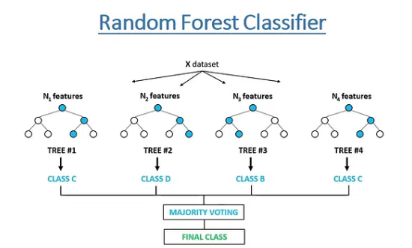
RANDOM FOREST
Definition: A supervised learning algorithm for classification and regression.
Working: Builds multiple decision trees using random subsets of data and features.
Prediction:
Classification: Majority voting.
Regression: Averaging tree outputs.
Key Features: Reduces overfitting, handles non-linear relationships, and works well with large datasets.
Notes:
Random Forest is a machine learning algorithm that creates multiple decision trees using random parts of the data and combines their predictions. For classification, it uses majority voting, and for regression, it averages the outputs. It’s accurate, reduces overfitting, and works well with large datasets, but it can be slow and less interpretable.

Slide 23
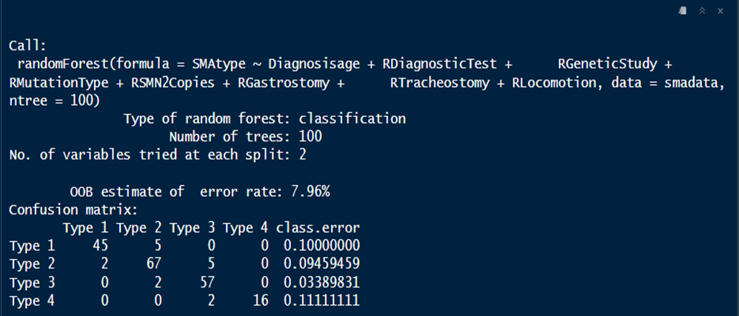
RANDOM FOREST
Random Forest Model
Notes:
The Random Forest Model summary. Variables Diagnosis age, Diagnostic test, Genetic Study, Mutation Type, No. of SMN2 Copies, Gastrostomy, Tracheostomy and locomotion were taken into consideration to classify SMA Type. The number of trees in the forest are 100, with 2 variables at each split. 1. Overview of the Model
Type of Model: Random Forest classification was used to predict the SMA type (SMAtype) based on clinical and diagnostic features.
Number of Trees: The model was trained with 100 trees, which balances performance and computational efficiency.
Features Used:
Diagnosisage, RDiagnosticTest, RGeneticStudy, RMutationType, RSMN2Copies, RGastrostomy, RTracheostomy, and RLocomotion.
Error Rate: The out-of-bag (OOB) error rate is 7.96%, indicating good model performance.Confusion Matrix:Class predictions for SMA types are mostly accurate. Key Observations:
Most Accurate: Type 3 (lowest error, 3.39%).
Misclassification is low across all types, with the highest individual class error being 11.11% (Type 4).

Slide 24
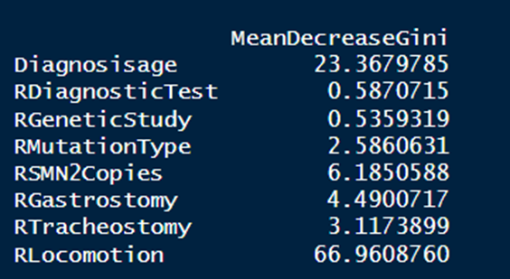
RANDOM FOREST
GINI IMPORTANCE
Notes:
Variables RLocomotion and Diagnosis Age have the highest Gini importance with values 66.96 and 23.26 respectively. RLocomotion is the most important variable (66.96), contributing significantly to the classification performance. Other important variables include Diagnosissage (23.37) and RSMN2Copies (6.18). Variables such as RDiagnosticTest and RGeneticStudy have much lower importance scores, indicating they contribute less to the model.

Slide 25
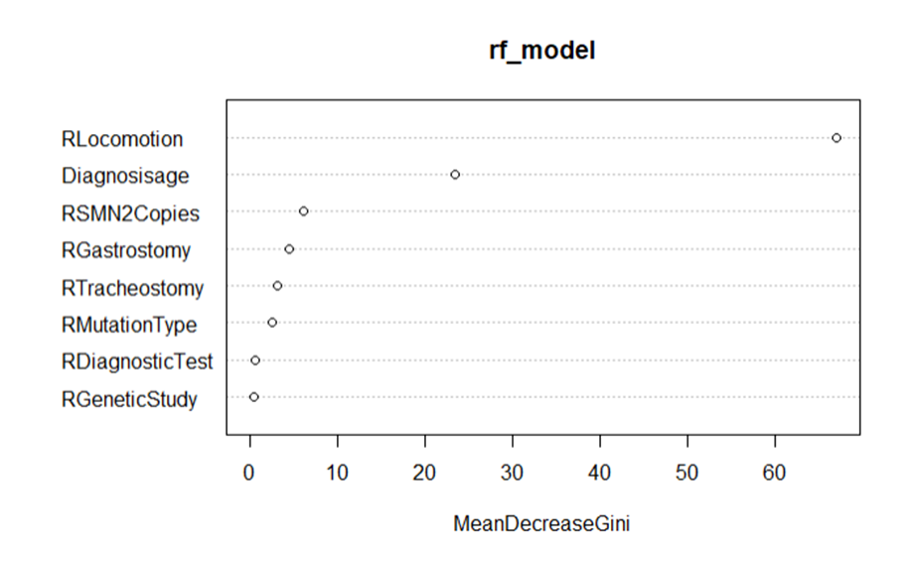
RANDOM FOREST
Notes:
The plot provides a clear ranking of which features are most influential in predicting the target variable, helping in both model interpretation and domain insights.

Slide 26


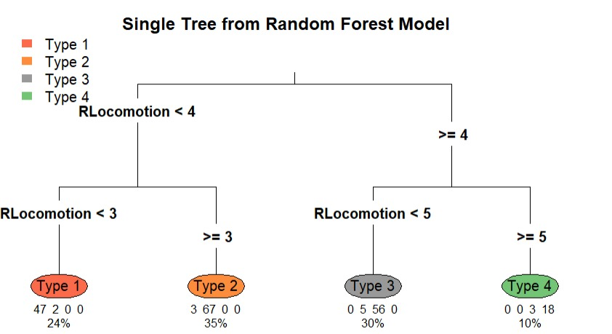
RANDOM FOREST
Notes:
Random Forest is a machine learning algorithm that creates multiple decision trees using random parts of the data and combines their predictions. For classification, it uses majority voting, and for regression, it averages the outputs. It’s accurate, reduces overfitting, and works well with large datasets, but it can be slow and less interpretable.

Slide 27
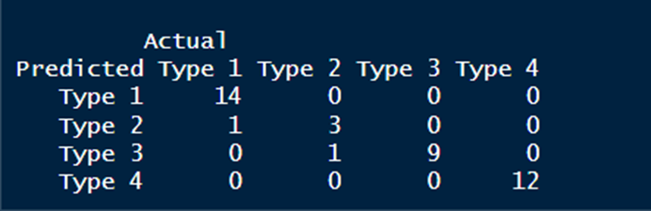
RANDOM FOREST
Confusion Matrix
Notes:
Explanation of Each Cell
Type 1 (Row 1):
True Positives (TP): 15 instances of Type 1 were correctly predicted.
False Negatives (FN): 0 Type 1 instances were incorrectly classified as another type.
Type 2 (Row 2):
True Positives (TP): 3 Type 2 instances were correctly predicted.
False Positives (FP): 1 instance of another type (Type 3) was incorrectly classified as Type 2.
False Negatives (FN): No actual Type 2 instances were misclassified.
Type 3 (Row 3):
True Positives (TP): 9 Type 3 instances were correctly predicted.
False Negatives (FN): 1 Type 3 instance was incorrectly classified as Type 2.
Type 4 (Row 4):
True Positives (TP): 12 Type 4 instances were correctly predicted.
False Negatives (FN): No Type 4 instances were misclassified.

Slide 28
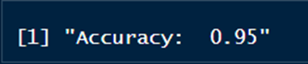
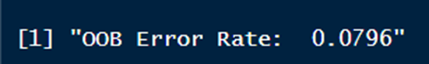
RANDOM FOREST
Accuracy
OOB Error Rate
Notes:
Explanation of Each Cell
Type 1 (Row 1):
True Positives (TP): 15 instances of Type 1 were correctly predicted.
False Negatives (FN): 0 Type 1 instances were incorrectly classified as another type.
Type 2 (Row 2):
True Positives (TP): 3 Type 2 instances were correctly predicted.
False Positives (FP): 1 instance of another type (Type 3) was incorrectly classified as Type 2.
False Negatives (FN): No actual Type 2 instances were misclassified.
Type 3 (Row 3):
True Positives (TP): 9 Type 3 instances were correctly predicted.
False Negatives (FN): 1 Type 3 instance was incorrectly classified as Type 2.
Type 4 (Row 4):
True Positives (TP): 12 Type 4 instances were correctly predicted.
False Negatives (FN): No Type 4 instances were misclassified.

Slide 29
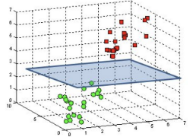
Support Vector Machine (SVM)
Uses separating hyperplane (Support Vector)
Kernel Function
Chooses the hyperplane w/ maximum distance b/w 2 set of points

Slide 30
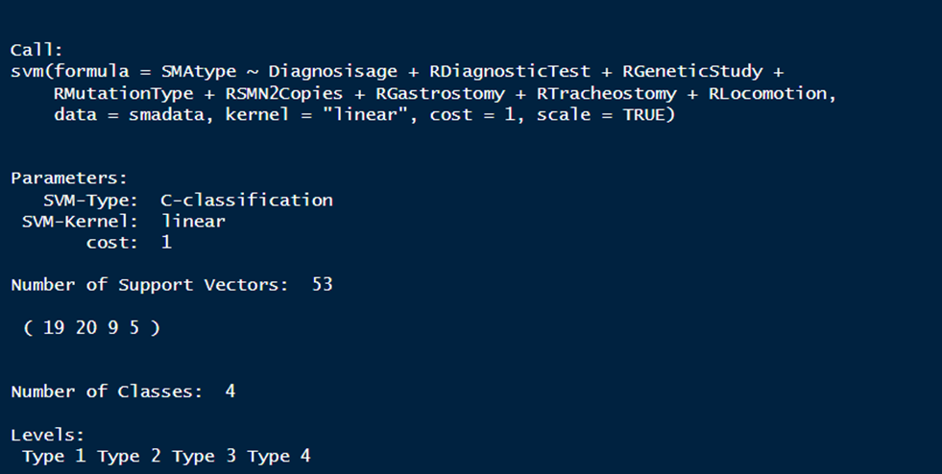
SVM
Model Building

Slide 31

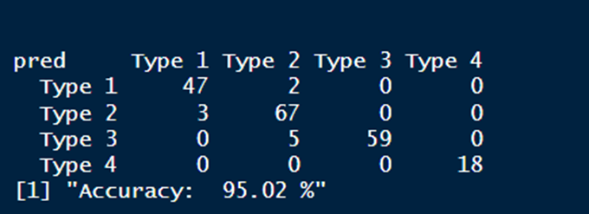

SVM
Confusion Matrix

Slide 32
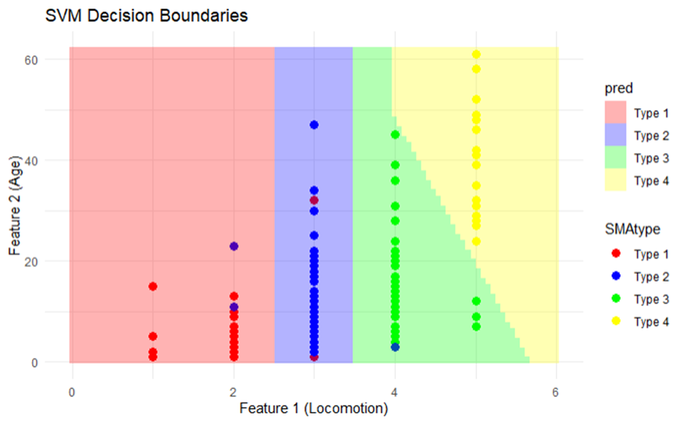
SVM
The 2-D visualization of SVM Decision Boundaries

Slide 33
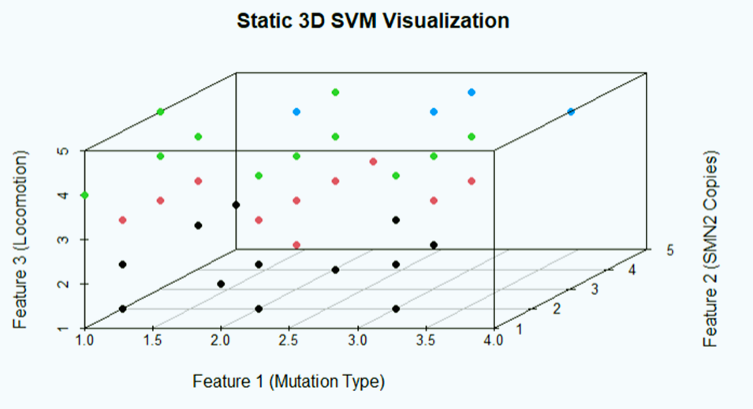
SVM
The 3-D visualization of SVM Decision Boundaries

Slide 34
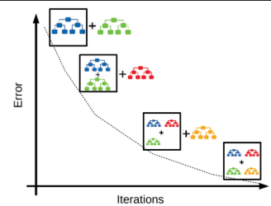
Gradient Boosting Model (GBM)
Machine learning technique used for regression, classification, and ranking problems.
Builds a predictive model in a step-by-step manner by combining the predictions of multiple weak learners.
Uses decision trees to create a strong predictive model.
Notes:
XGBoost model setup for multi-class classification with 4 classes. Key parameters include a learning rate (eta) of 0.1, maximum tree depth of 4, and 9 features. The training runs for 100 iterations (niter) with evaluation logging and early stopping enabled for performance tracking.

Slide 35
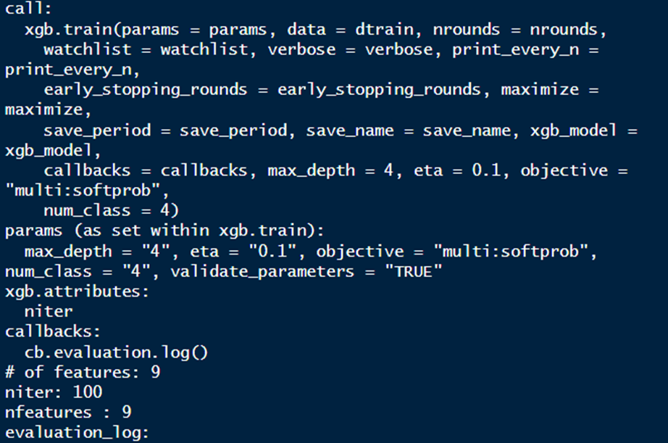
Gradient Boosting Model (GBM)
Notes:
XGBoost model setup for multi-class classification with 4 classes. Key parameters include a learning rate (eta) of 0.1, maximum tree depth of 4, and 9 features. The training runs for 100 iterations (niter) with evaluation logging and early stopping enabled for performance tracking.
XGBoost is an implementation of the gradient boosting algorithm optimized for speed and performance. It builds multiple decision trees iteratively, where each tree corrects the errors of the previous one. The final prediction is made by combining the predictions from all trees.

Slide 36
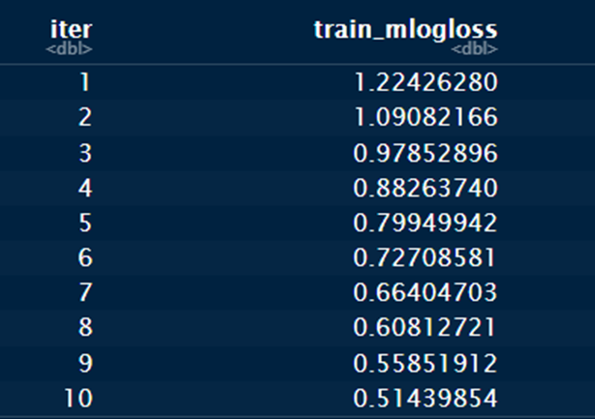

XGBOOST
Loss value with each subsequent iteration
Notes:
showing the multi-class logarithmic loss (train_mlogloss) over iterations (iter). Here's the interpretation:
Metric: train_mlogloss is decreasing steadily, indicating that the model's performance is improving as training progresses.
Trend: Over 10 iterations, the loss reduces significantly, from 1.22 in the first iteration to 0.51 in the tenth, showing effective learning by the model.

Slide 37
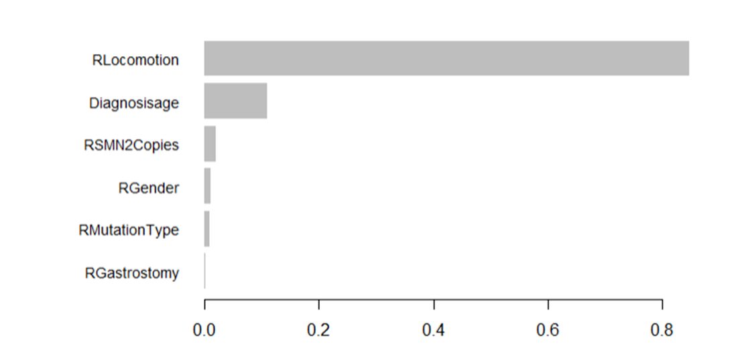
XGBOOST
Feature Importance Plot
Notes:
shows the feature importance in the XGBoost model. RLocomotion has the highest importance, followed by Diagnosisage, while features like RSMN2Copies, RGender, RMutationType, and RGastrostomy have minimal influence on the model's predictions. The chart highlights which features contribute most to model performance.

Slide 38
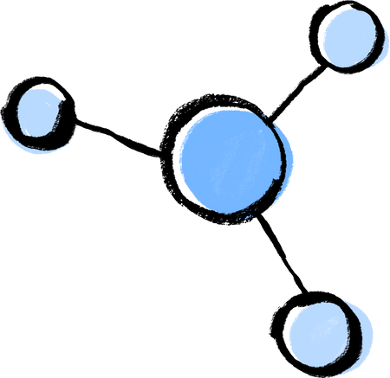
CONCLUSION
Best Performing Models: Both Random Forest (RF) and Support Vector Machine (SVM) demonstrated excellent performance with an accuracy of approximately 95%.
- Random Forest: Ideal for interpretability and handling noisy data, making it suitable
for complex datasets with diverse features.
- Support Vector Machine: Particularly effective for scenarios requiring precise decision boundaries,
showcasing its strength in managing complex feature interactions.
Gradient Boosting (XGBoost): Although effective, it achieved a slightly lower accuracy (93.44%). It remains valuable for its ability to iteratively correct model errors and handle nonlinear patterns but fell short of RF and SVM in this study.

Slide 39





Most important Features for SMA Prediction
·Locomotion: Most impactful across all models, indicating a significant role in distinguishing SMA types.
·Diagnosis Age: Second most important, emphasizing the criticality of early diagnosis.
·Number of SMN2 Copies: Frequently ranks high, reflecting its genetic relevance to SMA type determination.
Mutation Type: Contributed significantly in SVM
and GBM visualizations, reinforcing its
genetic influence.
CARRIER FATHER
CARRIER MOTHER
UNAFFECTED
CHILD
CHILD
CARRIER
CHILD
CARRIER
CHILD
WITH CF
25%
50%
25%

Slide 40
IMPROVEMENTS
The analysis was done on a dataset with data of 201 patients from South America.
The accuracy of the models, especially Support Vector Machine (SVM) can be improved by increasing the number of patients
datapoints from a diverse geography and demographics.
Other gene factors, such as the expression of IGHMBP2 gene, MORC2 gene, UBA1 gene, DYNC1H1 gene, BICD2 gene,
TRPV4 gene in SMA individuals can be explored and data collected to be used for Model building and classification.

Slide 41
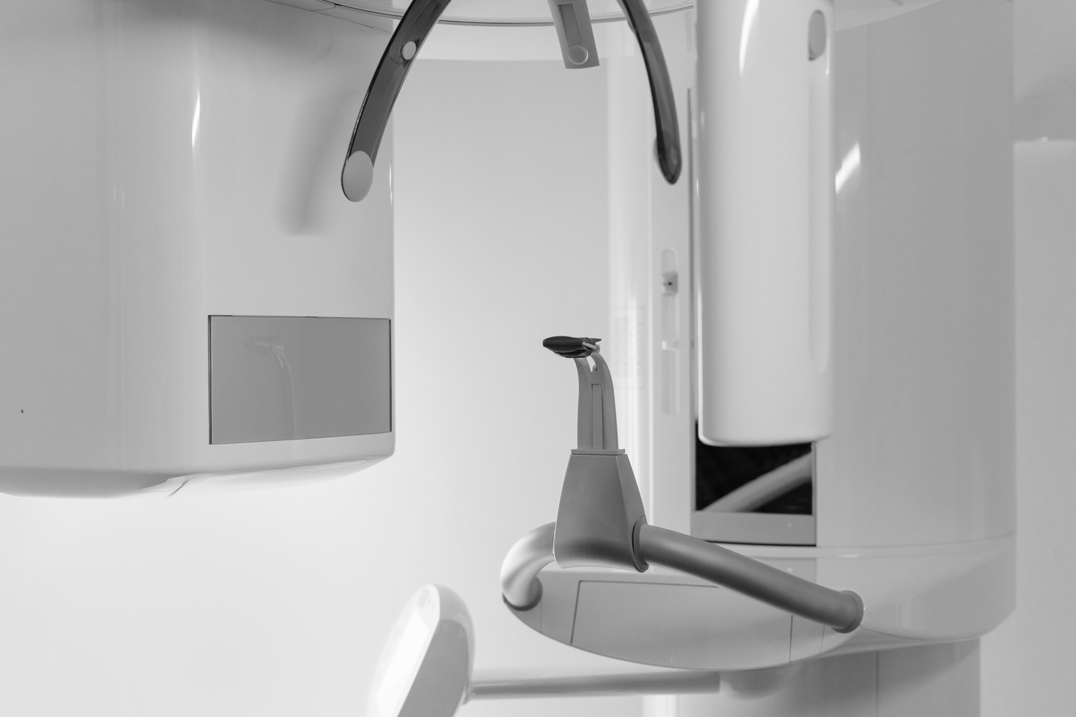


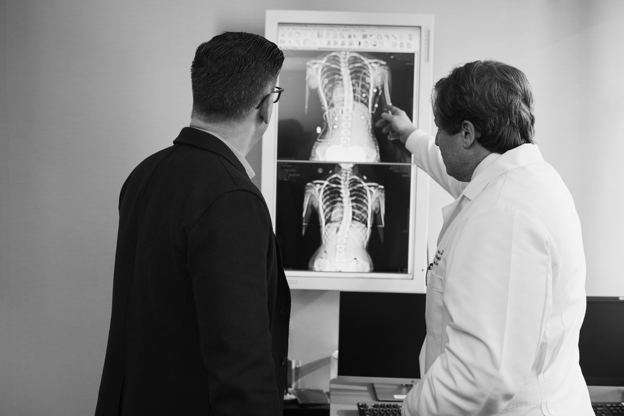
THANK YOU

Slide 42
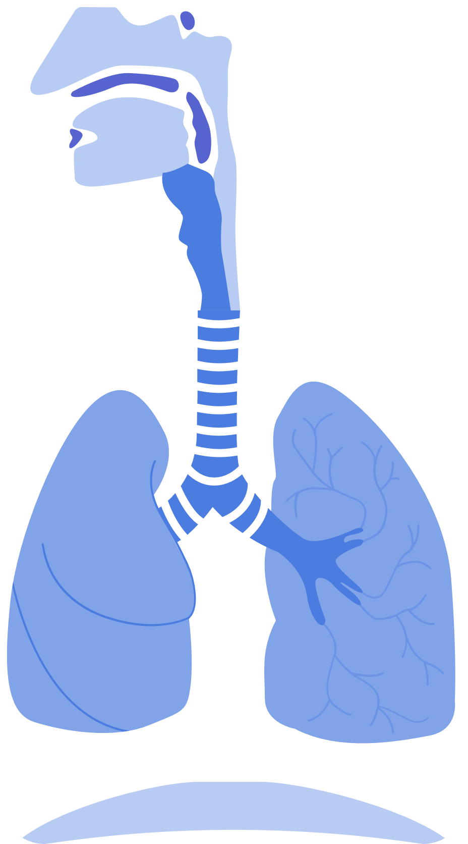
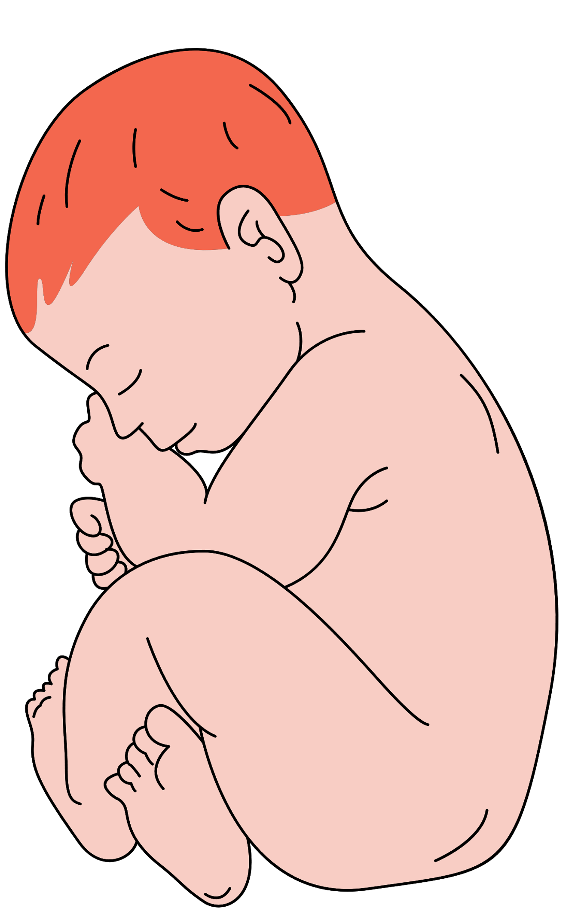


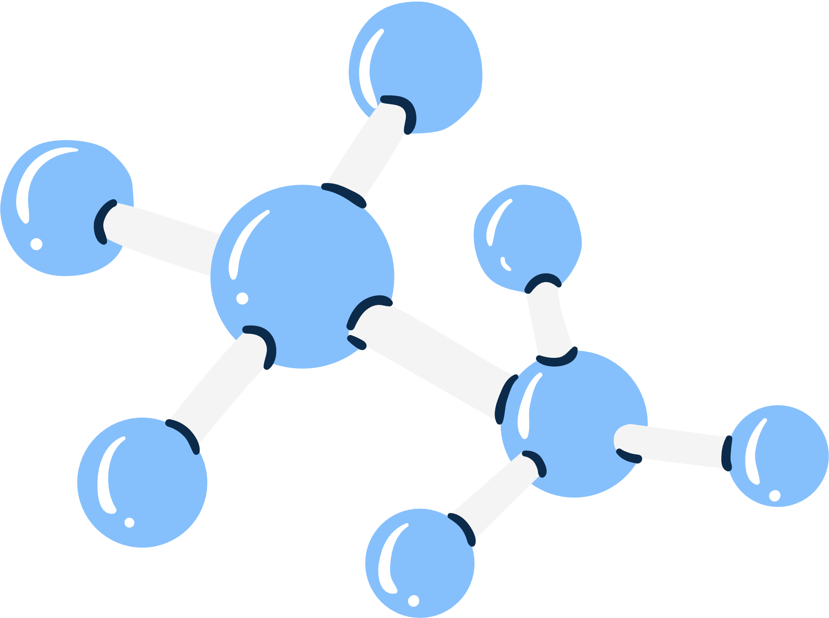







RESOURCE PAGE
This presentation template uses the following free fonts:
Titles :
Overpass
Headers :
Overpass
Body Copy :
Overpass
You can find these fonts online too.
COLORS
#73B5FE
#0C2B4A

